Slide 1
MIS 4470 Final Project Presentation
Energizing America: A Deep Dive into 50 Years of Trends and 5 Year Projections
By: Deepa Palariya
To: Prof. Mark Isken

Slide 2
Topics
Dataset
Data Preparation and Cleansing
Introduction
EDA
Winters Exponential Smoothing Model
ARIMA
SARIMA
Recurrent Neural Networks (RNN)
Long Short-Term Memory (LSTM)
Gated Recurrent Units(GRU)
XGBoost (Extreme Gradient Boosting)
Comparison and Conclusion

Slide 3
Dataset
Dataset from U.S. Energy Information Administration: https://www.eia.gov/opendata/
Monthly data (1973-2022)
Dependent Variables: Energy Consumption & Production
Independent Variables: Exports, Imports, Industrial & Residential Consumption, Stock Change, Time(t)

Slide 4
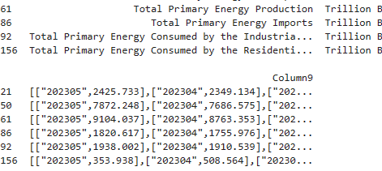
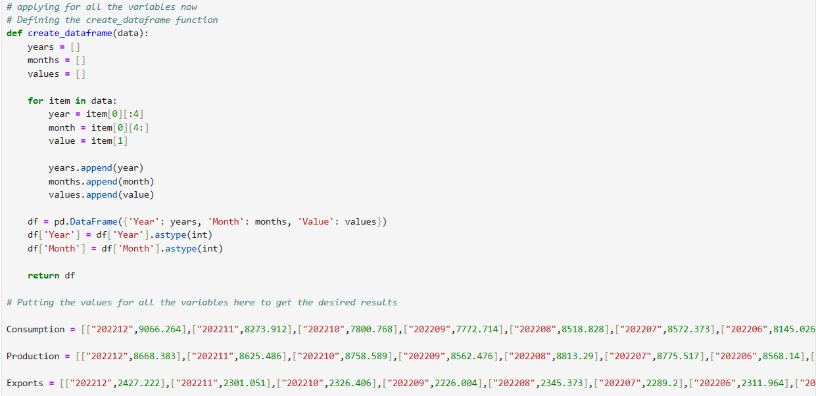
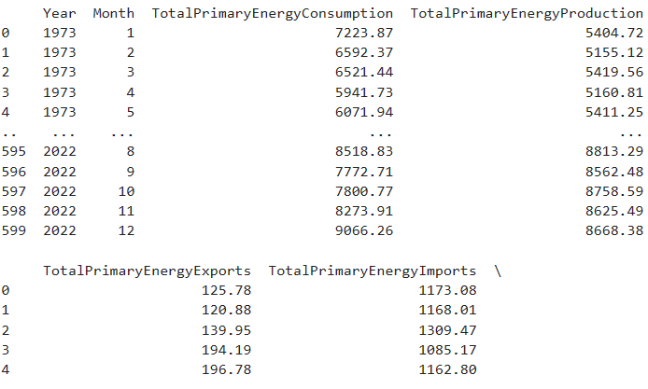
Data Preparation and Cleansing

Slide 5
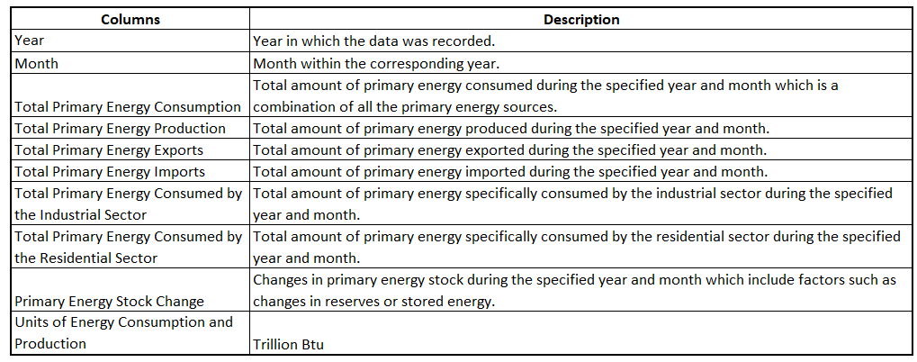
Introduction
Constructed and assessed various models, comparing actual versus forecasted values.
Utilized all features except the target variable itself for modeling the target variables.
Features selected based on significance F-test, correlation, and trial-and-error.

Slide 6
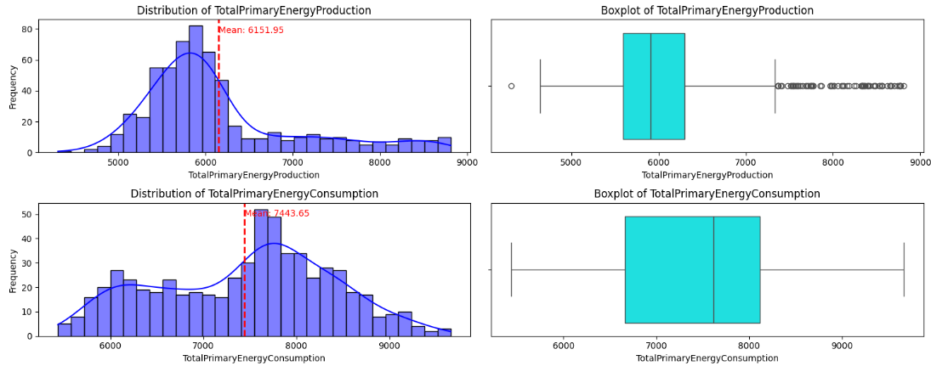
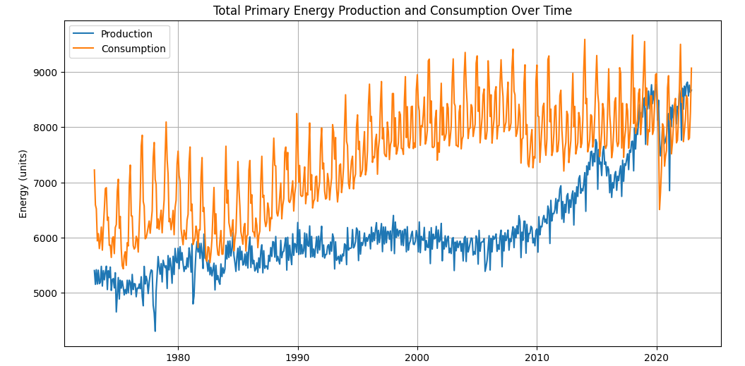
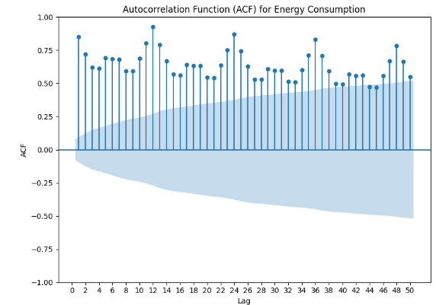
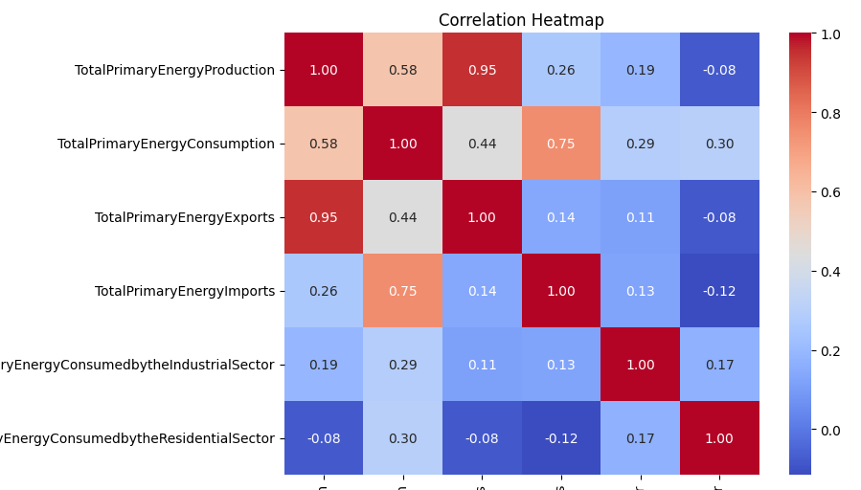
EDA

Slide 7
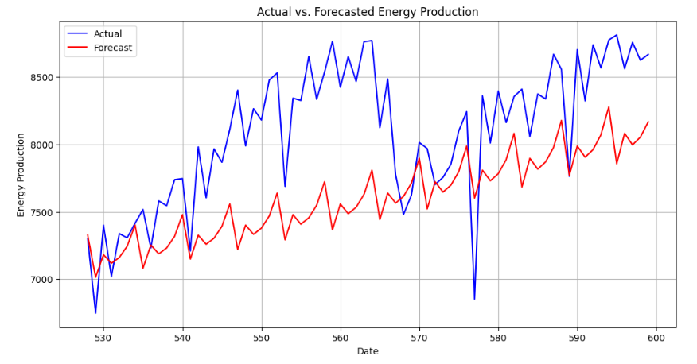
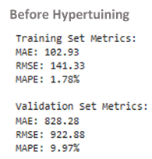
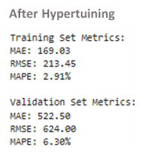
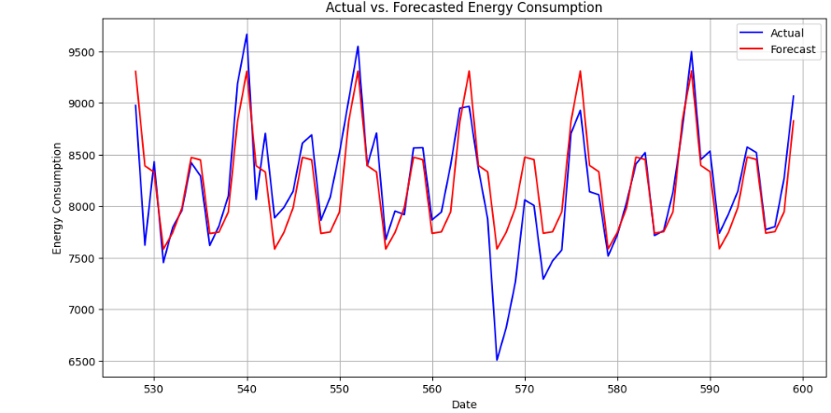
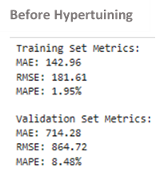
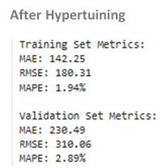
Winters Exponential Smoothing Model
Analysis: After hyperparameter tuning, overfitting decreased, although there was not a significant improvement in performance. This observation is supported by the actual and forecast plots for both Consumption and Production.

Slide 8
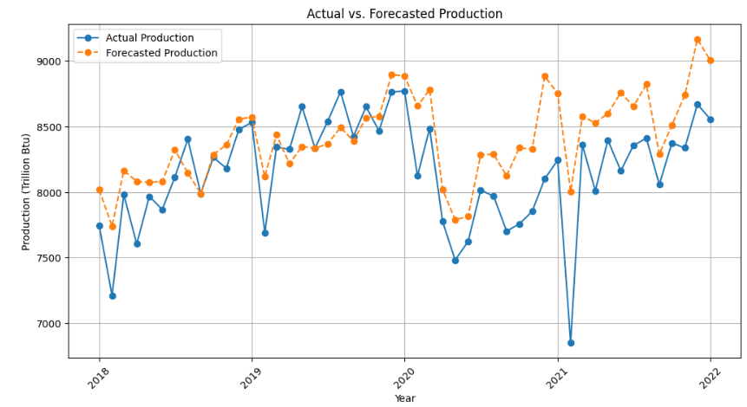
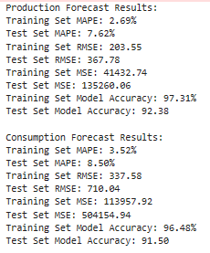
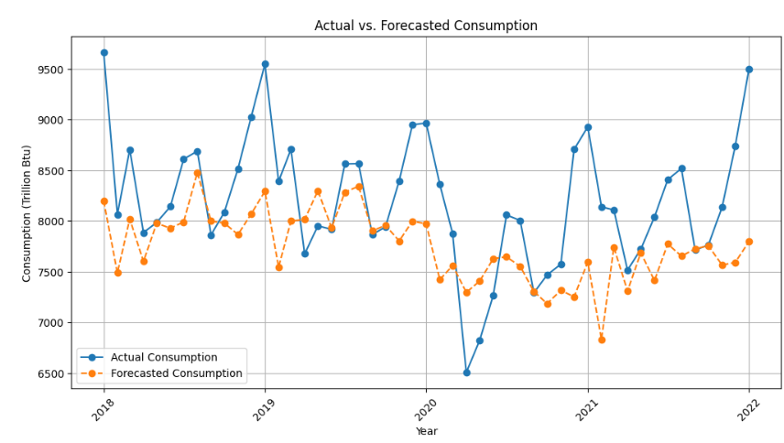
ARIMA
Analysis: The favorable performance indicated by MAPE, RMSE, MSE, and accuracy metrics suggests effective modeling for both Consumption and Production. However, there is a noticeable presence of overfitting, as reflected in the corresponding plots.

Slide 9
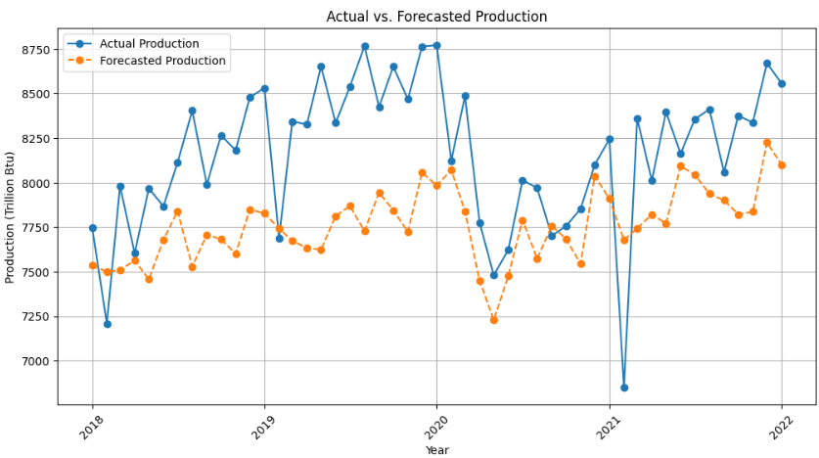
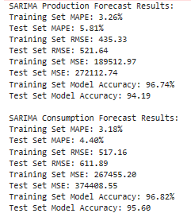
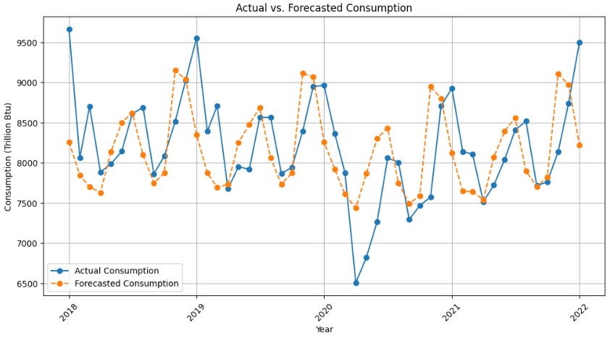
SARIMA
Analysis: The metrics such as MAPE, RMSE, MSE, and accuracy suggest that SARIMA effectively modeled both Consumption and Production. Despite a slight presence of overfitting, the plots demonstrate good performance as well.

Slide 10
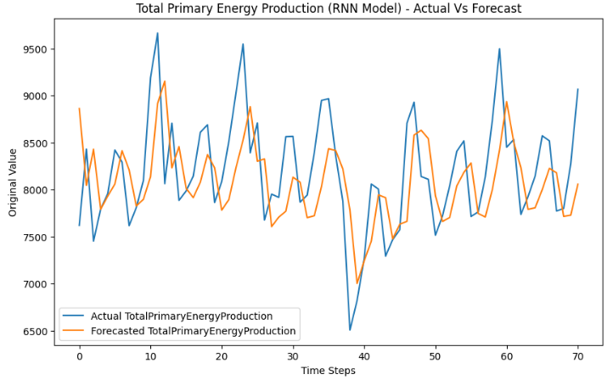
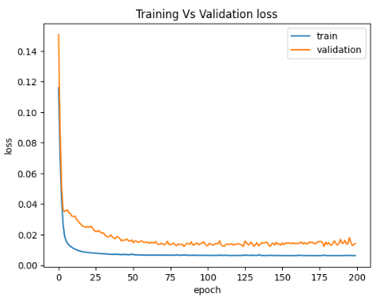

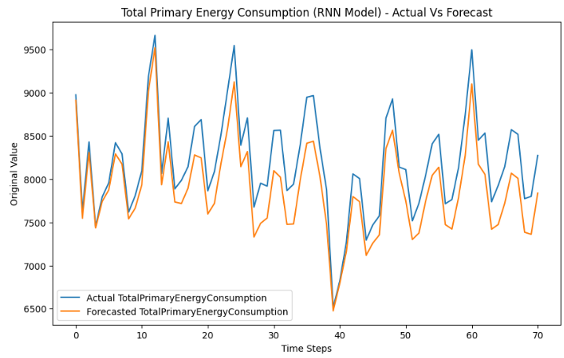
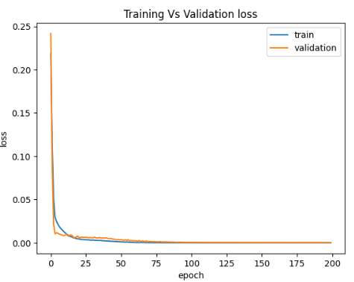

Recurrent Neural Networks (RNN)
Analysis: MSE, RMSE, and MAE are all favorable for the test set in both Production and Consumption, suggesting satisfactory model performance. This observation is further supported by the visual examination of the plots.

Slide 11


Long Short-Term Memory (LSTM)
Analysis: Considering that LSTM is an extension of RNN, there was an expectation of good performance from the model.
Following the evaluation metrics, including MSE, RMSE, and MAE, all indicating positive outcomes for the test set in both Production and Consumption, it suggests that the model performed well.
However, it's worth noting that the LSTM model demonstrated performance that was quite similar to the RNN model, with only slight variations in the error rates..

Slide 12
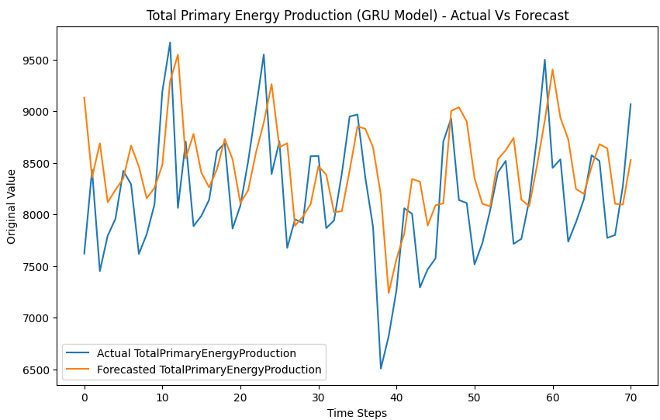

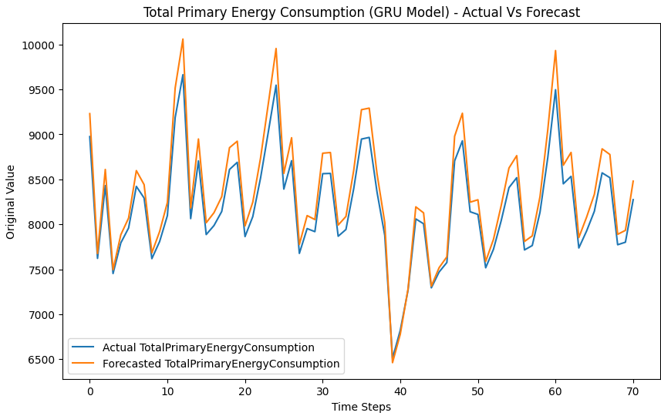

Gated Recurrent Units(GRU)
Analysis: The GRU model demonstrates excellent performance on the test set, as evidenced by remarkably low values for MSE, RMSE, and MAE. The accuracy of the forecasts is further confirmed through the visual examination of the actual and forecast plots, highlighting the model's precision.

Slide 13
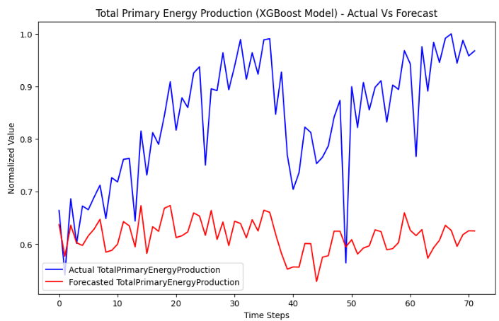

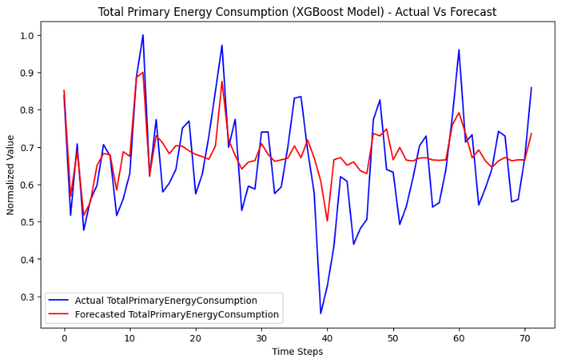

XGBoost (Extreme Gradient Boosting)
Analysis: Despite seemingly favorable MSE and MAE results for both Production and Consumption, the discrepancy observed in the plots suggests that the model may not have effectively captured the expected patterns.

Slide 14
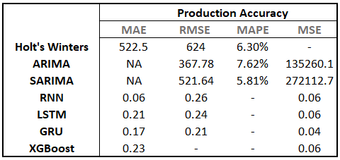
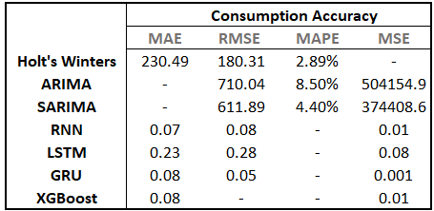
Comparison and Conclusion
For both Consumption and Production variables, traditional approaches such as Winters Exponential Smoothing, ARIMA, and SARIMA showed moderate accuracy.
In contrast, RNN, LSTM, GRU and XGBoost demonstrated a remarkable reduction in errors. The exploratory data analysis (EDA) highlighted complex seasonality, explaining the exceptional performance of Machine Learning models, known for their effectiveness in handling complex environments.
Among these four Machine Learning models, GRU outperformed all, as is evident in the actual and forecast plots.

